Slide 1
Preliminary Usability Test Results Presentation
Team 6: CS Scheduling App
Presenter:Thanuja Maddali

Slide 2
Usability Test Process
Welcome
Welcome participant, create relaxed atmosphere.
Introduce
Introduce app, explain usability test.
Confirm
Confirm consent, proceed with test.
Request
Request permission, begin testing.
Complete
Complete pre-test questionnaire.
Explain
Explain test scenarios, start testing.
Conduct
Conduct interviews, ask relevant questions.
Fill
Fill post-test questionnaire, bug report.
Thank
Thank participant for participation.

Slide 3
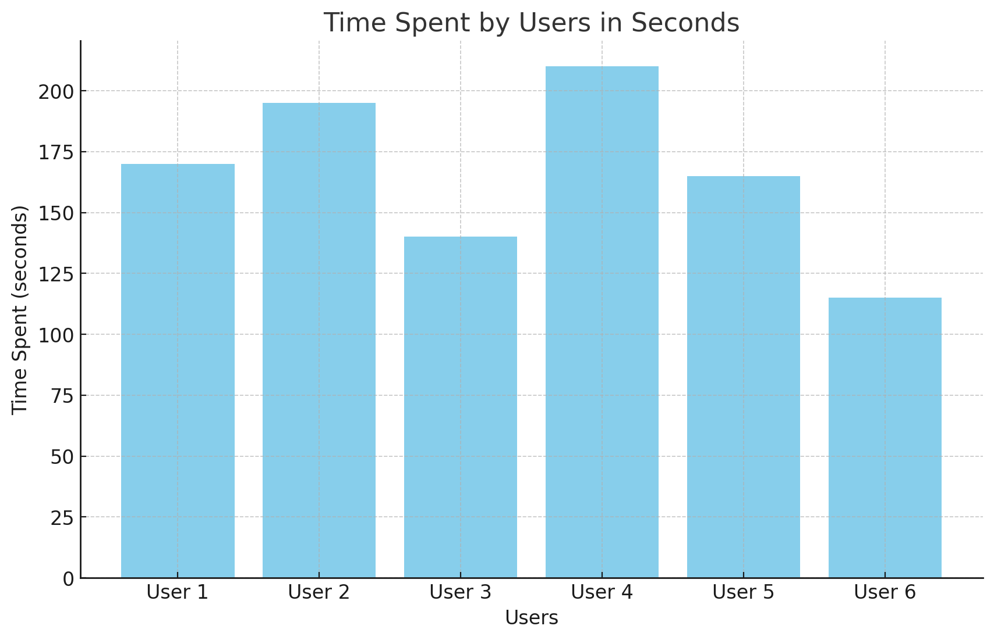
Test Scenario 1
ACTION
Participants were asked to access the website and try to navigate Each menu section and understand the information.
QUESTIONS ASKED
Is it easy to Navigate and log into the App?
Was Content Provided Comfortable to read?

Slide 4
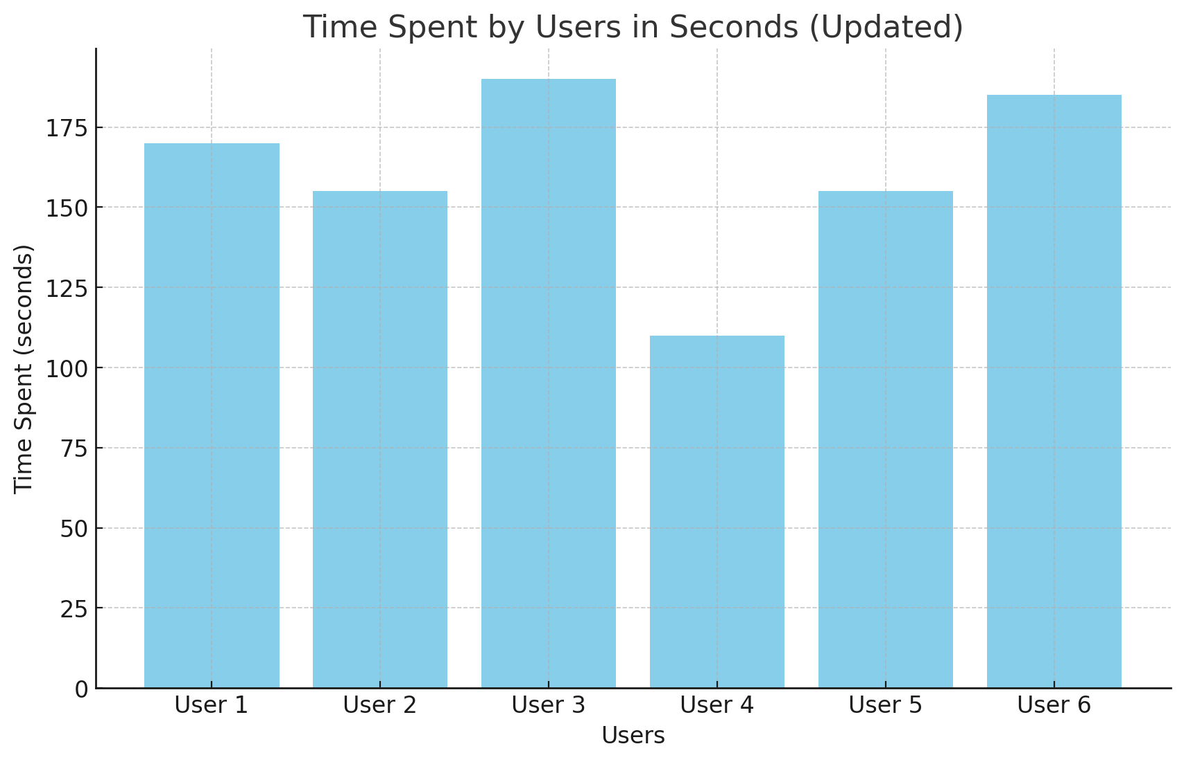
Test Scenario 2
ACTION
Participants were asked to use the Add item Feature to add the course and view in the calendar
QUESTIONS ASKED
How Comfortable did you feel while using the Add item Feature?
Is it easy to Add course and view in the calendar

Slide 5
Bugs Report
In Section List View, Filter for Building Name and Class days is Not Working
The Course, Instructor, and Building fields were being duplicated in the Add Item section.

Slide 6
RECOMMENDED CHANGES
Changes in the Calendar View should occur automatically.
Help Section needed to navigate through each section
In Add item Section,Changes Should Occur Automatically without using Refresh.
Am and Pm Should be Fixed in Add Item Section
Help Section to navigate through sections

Slide 7
THANK YOU

